Slide 1

Management
&
The Manager
What's the difference?
Intellectual framework?
Bosses' Day or Boss' Day) is generally observed on or around October 16th (USA)

Slide 2
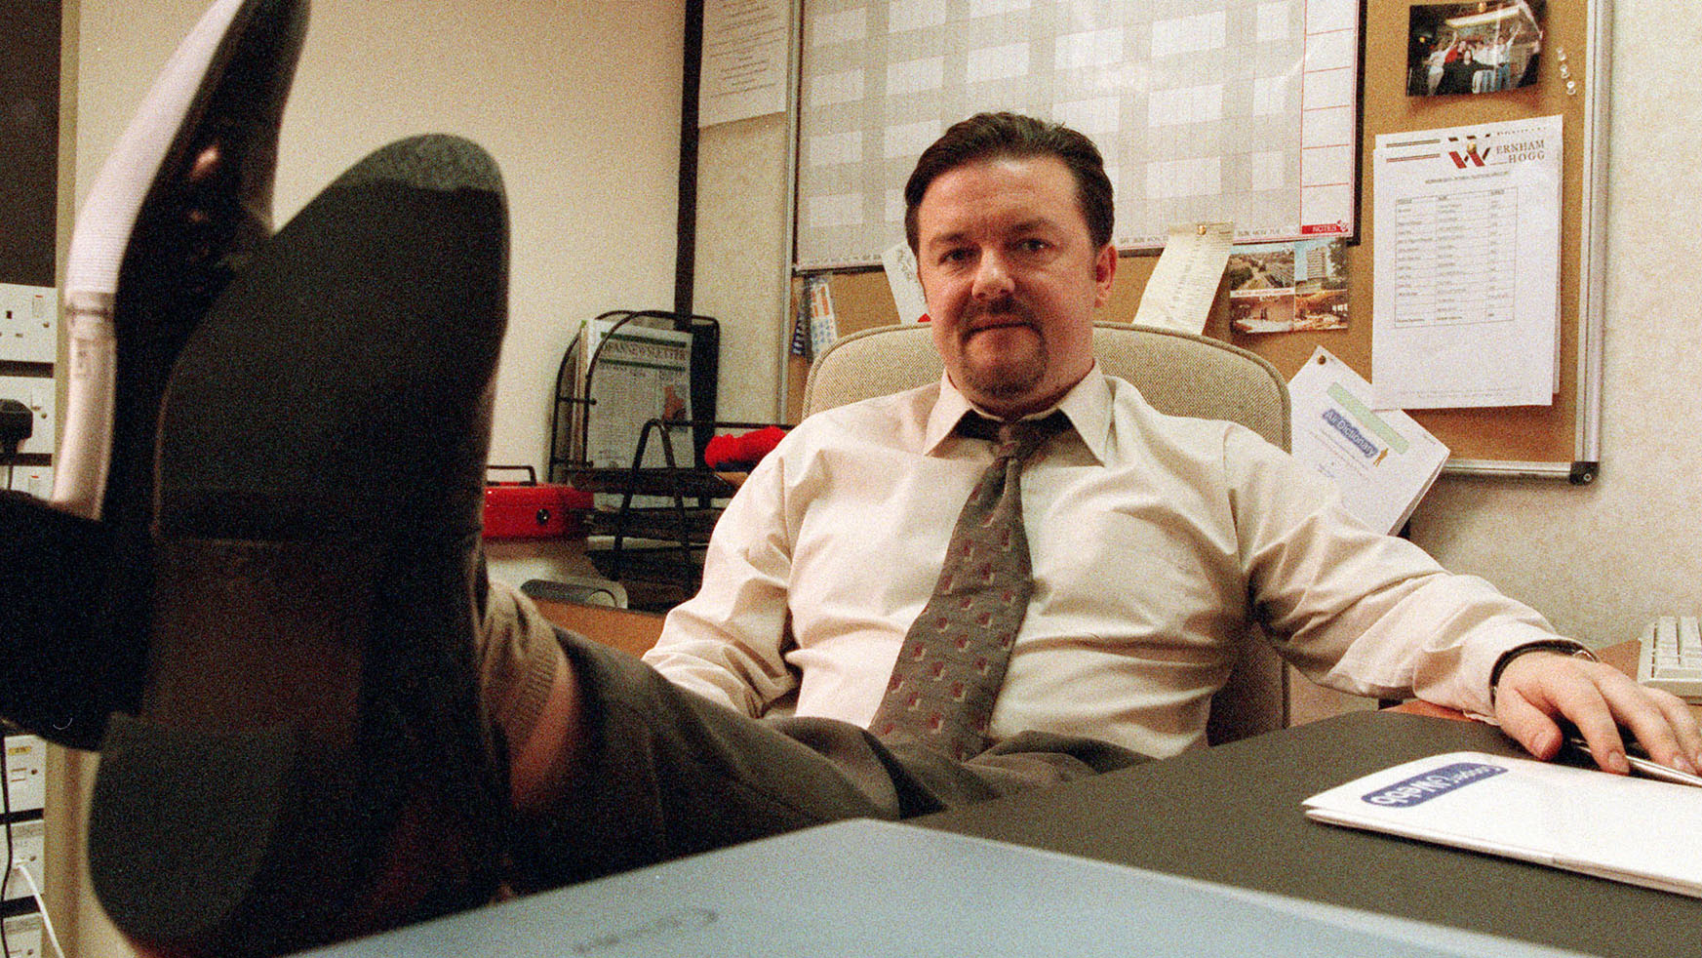
Management Definitions
No generally accepted definition of ‘management’ as an activity
Classic definition is considered to be that of Fayol
  “To manage is to forecast and plan, to organise, to command, to coordinate and to control.” Fayol (1916)

Slide 3
Rational Goal Models
Frederick Taylor (1947) Ford
Max Weber (1925) Bureaucracy
Rationality and scientific
Division of labour, highly specialised
Systems and procedures
Managerial hierarchy versus the workers
Employees tend to work to economic self-interest
Henri Fayol (1949) Art
of Management
Core management task – planning, organisation of work, control coordination
Effective management – unity of command, consistency of purpose, order, place for everything, operation of ‘equity’, operating within the spirit of the law, long-term employment
Science, not rule of thumb
Harmony, not discord
Cooperation, not individualism
Analyses and synthesizes workflows
Main objective is improving economic efficiency, especially labour productivity

Slide 4

Management
Managers can also be supervisors; and supervisors in turn can be expected to practise management skills
Three elements to manage
  Goals
  Resources
  Peoples
Some managers especially those with a technical speciality may not have staff to supervise or manage, they may manage plant, equipment, or processes

Slide 5
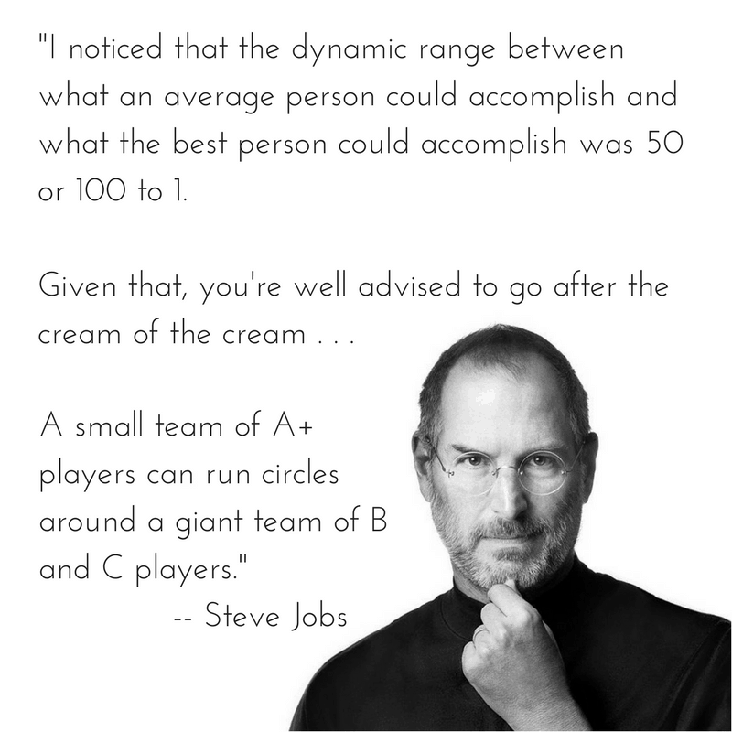
Management & Manager
Rise of scientific management in USA
British reaction – Elbourne (1914) ‘Factory Administration’
    Saw scientific management in an unfavourable light
    Argued that ‘golden rules’ could never be a substitute for ‘good men’
Checkland (1983:225)
    “Business man was still in control, but he no longer had a confident rationale of what he was doing, no confirmatory theory of economy and society, and no sustaining set of moral and religious beliefs.”

Slide 6
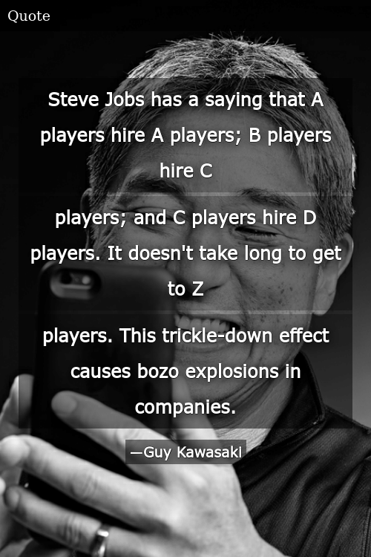
Development of Management Theory
  Earliest contributors were practicing managers and social scientists
  Practicing Managers
    Taylor
    Fayol
  Social Scientists
    Mayo
    McGregor

Slide 7

Taylor
Scientific Management
  Time and quantity – analysed and timed movements
  Worked out piece rates
  Increased production, and (often) pay
  Workers felt that working harder would exhaust the number of available jobs
  There was a certain amount of work to be done - if you worked harder, you would cut down the extent of that finite amount

Slide 8
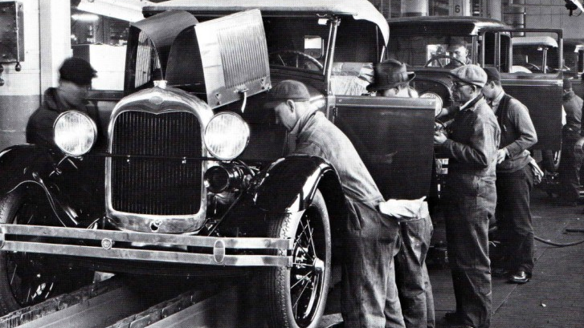
Rational Goal Models
  Successful in their time
  Operated in large organisations with dominant positions in their markets who wanted to eliminate potential competitors
  1970’s growth of regulatory environment aimed at preventing or breaking up monopolies
  Governments passing legalisation to promote privatization
  Industrial reorganization
  Unable to react to rapid changes in the marketplace such as technological changes in IT
  Lack of employee empowerment/ flexibility had negative effect on employee motivation and commitment

Slide 9
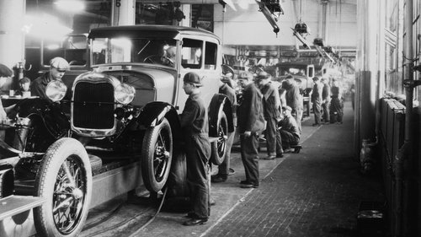
Scientific Management (1890-1940)
At the turn of the century, the most notable organisations were large and industrialised
Often included ongoing, routine tasks that manufactured a variety of products
The United States highly prized scientific and technical matters, including careful
measurement and specification of activities and results
Management tended to be the same. Frederick Taylor developed the “scientific management theory” which espoused this careful specification and measurement of all organisational tasks
Tasks were standardized as much as possible
Workers were rewarded and punished
This approach appeared to work well for organisations with assembly lines and other mechanistic, routinized activities

Slide 10
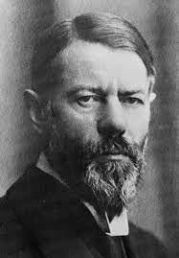
14 Principles of Management (Fayol)
Management was an acquired skill and that it had universal application, including in the home
Division of labour
Authority
Discipline
Unity of command
Unity of direction
Subordination of individual to common goal
Remuneration for effort
Centralisation
Chain of command
Order
Equity
Stability
Initiative
Team spirit
“The manner in which the subordinates do their work has incontestably a great effect upon the ultimate result, but the operation of management has much greater effect.”

Slide 11
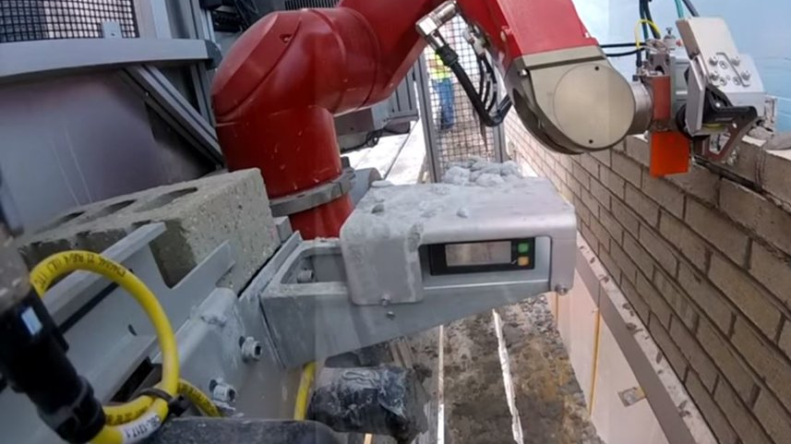
Gilbreth
  Motion study into efficiency
  Bricklaying, reduced 18 motions to 4
  Proposed that each worker should be involved in doing own job
  Preparing for next higher level
  Training their successors

Slide 12

Bureaucratic Management (1930-1950)
Max Weber embellished the scientific management theory with his bureaucratic theory
Weber focused on dividing organisations into hierarchies, establishing strong lines of authority and control
He suggested organisations develop comprehensive and detailed standard operating procedures for all routinized tasks
Weber - bureaucracy needed to ensure stability
Leaders usually inherit status and authority, do not always have "charisma" - therefore, division of labour is required - hierarchy and authority - rules and regulations

Slide 13
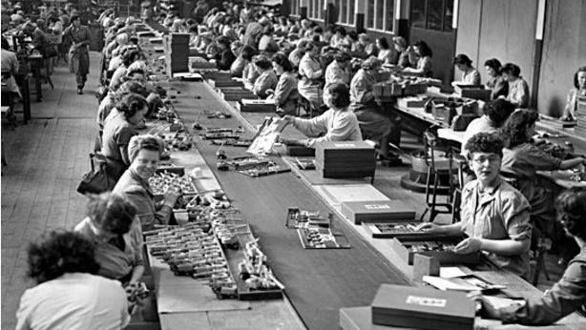
Human Relations Model
Elton Mayo (1933)
Measuring productivity (Hawthorne Effect)
Encouragement better than coercion
Peer group influence high, importance of informal groups
Concepts of participation, trust, team working & openness
Supported by growing personnel profession
Conflict between Rational Goal & Human Relations

Slide 14
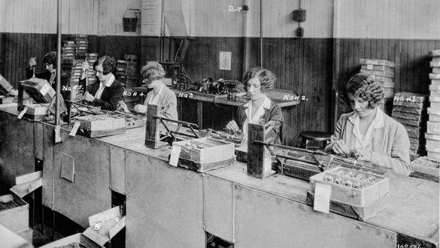
Mayo
Hawthorne Studies
Production increased when workers knew they were part of a project
Group/peer pressure was important even in tedious work
Workers not machines - growing interest in the human resource

Slide 15
Hawthorne Studies
Experiments on Illumination
Intended to study the conditions of work
The main aim was to study the relationship between intensity of illumination and output
Disappointing to the investigators as employees reacted not to actual illumination changes but to some other variable and hence no real change in production had been registered (two groups of employees, evenly matched, isolated – Laboratory, Control Group)
Relay Assembly Experiment
Illumination experiments had not been satisfactory owing to lack of control over other variables influencing employee performance
The aim of the Relay Assembly Test room study was to study the effect of hours of work (or fatigue) and
Rest pauses on output (isolated, manipulating working conditions monitoring output)
Mass Interviewing Programme
Relay Assembly demonstrated the positive relationship between the morale of employees and supervision
As an improvement in supervision was expected to increase employee morale and in turn production
Aim to study human relations and attitudes rather than changes in environmental conditions
Bank Wiring Observation Room
9 Wiremen, 3 Solder men and 2 Inspectors
Though a specific task was assigned to each of them, they had to collaborate with the others in the group
Observer and interviewer involved
Strong group formations and informal leaders resist changes introduced by the management and even exert pressure on employees which in turn results in a decline in production
Personnel Counselling
Required as the earlier four studies could not yield sufficient information regarding promoting employee relations
The aim of this study was to get a diagnosis of the problems of the employees

Slide 16

Human Relations Movement (1930-today)
Unions and government regulations reacted to the dehumanising effects of these theories
More attention was given to individuals and their unique capabilities in the organisation
A major belief included that the organisation would prosper if its workers prospered as well
Human Resource departments were added to organisations
The behavioural sciences played a strong role in helping to understand the needs of workers and how the needs of the organisation and its workers could be better aligned
Various new theories were spawned, many based on the behavioural sciences (Some had names like theory “X”, “Y” and “Z”)

Slide 17

Maslow (1943) Hierarchy of Needs
Maslow, self-actualizing people share the following qualities:
Truth: honest, reality, beauty, pure, clean and unadulterated completeness
Goodness: rightness, desirability, uprightness, benevolence, honesty
Beauty: rightness, form, aliveness, simplicity, richness, wholeness, perfection, completion
Wholeness: unity, integration, tendency to oneness, interconnectedness, simplicity, organization, structure, order, not dissociated, synergy
Dichotomy: transcendence: acceptance, resolution, integration, polarities, opposites, contradictions
Aliveness: process, not-deadness, spontaneity, self-regulation, full-functioning
Unique: idiosyncrasy, individuality, non comparability, novelty
Perfection: nothing superfluous

Slide 18
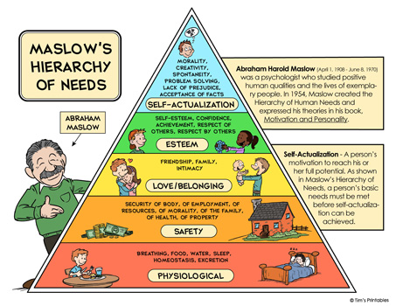

Slide 19

McGregor (1960)
Theory X & Theory Y
Behavioural theories emphasise human relationships, output, and performance
McGregor (1960) ‘The Human Side of Enterprise’ – influenced behavioural theories

Slide 20
Theory X & Theory Y Managers
Theory X Managers
The average human has an inherent dislike of work and will avoid it if possible
Because of this characteristic, most people must be coerced, controlled, directed, or threatened with punishment to get them to make adequate effort to achieve organisational objectives
The average human prefers to be directed, wishes to avoid responsibility, has relatively little ambition and desires security above all else
Theory Y Managers
The expenditure of physical and mental effort in work is as natural as play or rest, and the average human being, under proper conditions, learns not to accept but to seek responsibility
People will exercise self-direction and self-control to achieve objectives to which they are committed
The capacity to exercise a relatively high level of imagination, ingenuity, and creativity in the solution of organisational problems is widely, not narrowly, distributed in the population, and the intellectual potentialities of the average human are only partially utilised under the conditions of modern industrial life

Slide 21

Human Relations
Human Relations movement training programs recognized the need to cultivate supervisory skills, e.g., delegating, career development, motivating, coaching, mentoring, etc.
Effective management development programs help individuals take a system’s view of their organisations, including review of how major functions effect each other
Human Relations theory emphasises employee as a human being and should be treated as a human being but not a machine (Chand, 2017)

Slide 22
Individual Perspective Schools
Behaviourist
Behaviour is the result of an individual interaction with their environment
Passive - response to reward-enforcing
Cogs in a machine
Learned behaviour – Carrot & Stick
Gestalt-Field
Behaviour product of their environment and own reason
Learning is process of gaining changing
Expectation of thought process
Review of behaviours & response to the same
Maslow
Internal & External Stimuli
Pavlov & His Dog
Ring the Bell
Kurt Lewin & Field Theory
Behaviour exists at a point in time
Analysis as whole with component parts
Concrete person in a concrete situation

Slide 23
Group Dynamics School
Focus on the nature of groups. Influence of the group can overwhelm an individuals actions and tendencies, thus changing behaviour
Kurt Lewin
Group Dynamic
Willian Schutz (1966)
Interpersonal Relations
Inclusion, Control & Affection (Openness)
Wilfred Bion (1961)
Group dynamics for a psychoanalytic perspective
Bruce Tuckman (1965)
Forming
Storming
Norming
Performing
Added Ending
Influence as organisations view themselves as teams as opposed to a group of individuals
Team Building
Norms, roles and values challenged and changed

Slide 24

Contemporary Management Theories
Contingency Theory
Chaos Theory
Complexity Theory

Slide 25
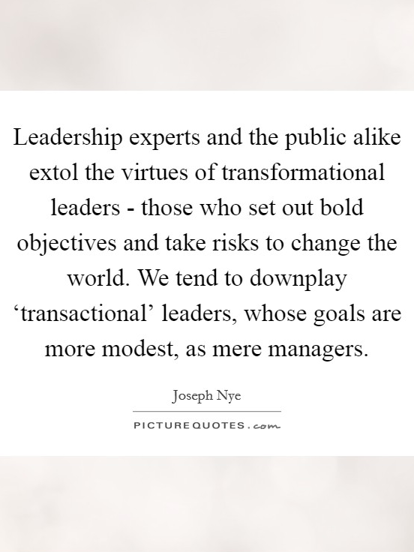
Contingency Theory
No one best practice in management. Depends on environment (Fielder, 1967)
Two prong process
  Design and the subsystems must fit with its environment i.e. the Weber and Taylorism system is best suited to prison (Command & Control)
  Human relations may be better in a creative environment such as media
Quality & style of leadership paramount in the implementation of management systems

Slide 26
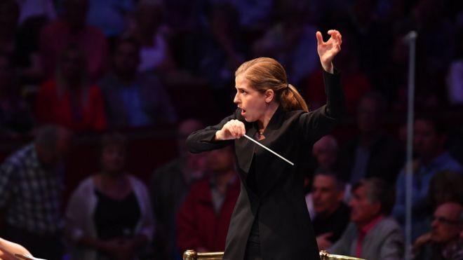
Contingency Theory
Allows for predicting the characteristics of the appropriate situations for effectiveness
    Group atmosphere
    Task structure
    Leader position, power
Favourable if there is
    Good leader-member relations
    Highly structured tasks
    High leader position power

Slide 27

Management & Organisation Theory (Handy, 1993)
Key variables a manager has to grapple with are:
  People
  Work and structures
  Systems and procedures
Three crucial constraints of the environment:
  Goals of the organisation
  Technology available
  Culture of the organisation (values, beliefs, etc.)
All six factors interact with each other
To change one of them will inevitably lead to change in one or more others
To manage successfully is to balance these factors in a way that meets the needs of the organisation at a particular period in time, this is essentially constitutes a contingency approach to management

Slide 28

Chaos Theories
Butterfly Effect adapted by Peters (1987)
Events can be rarely controlled especially in a global economy
As systems become more complex they become volatile and must expend more energy to maintain the complexity and therefore need bigger structures to maintain stability
Takes effective management system to identify what is happening and prevent collapse
Credit Crunch - banks, financial institutions and regulatory system, slow to act and poorly structured

Slide 29

Complexity Theory
Santa Fe Institute interdisciplinary field
Views organisations as complex evolving systems
Sits on the edge of order and chaos
Challenges the idea of striving for equilibrium rather organisation thrive when pushed away from the equilibrium

Slide 30
Evolution of Management Theory
Classical Approach & Scientific Management
The one best way to do the job
General theories on what managers do and what constitutes good management practice
Developed from about 1911 when Taylor's Principles of Scientific Management was published production was highly labour intensive
Fayol's functional view of management
Weber's discussions on the theories of bureaucracy
Behavioural Approach
People are good and essential - therefore, to stimulate performance, management needs to consider their needs and humanize work
Emphasis on group behaviour, motivation, job satisfaction, leadership, and communication
Quantitative Approach
Operations research and management science.: mathematical and statistical solutions to problems, optimization models, computer simulations
Most effective in management decision making rather than managerial behaviour
Not many managers familiar with the necessary tools.
Situational or Contingency Approach
Principles of management are not fixed but are affected by many variables - size, objectives, leadership styles, education and training of staff, availability of resources, nature of market, economic pressures, government policies.
Team Building Approach
Quality circles, best practice, continuous improvement
Reliance on teamwork
Flattening of management pyramid, reducing the levels of hierarchy
Consensus management - involving more people at all levels in decision-making.

Slide 31

How Great Leaders Inspire Action Simon Sinek https://www.youtube.com/watch?v=qp0HIF3SfI4

Slide 32
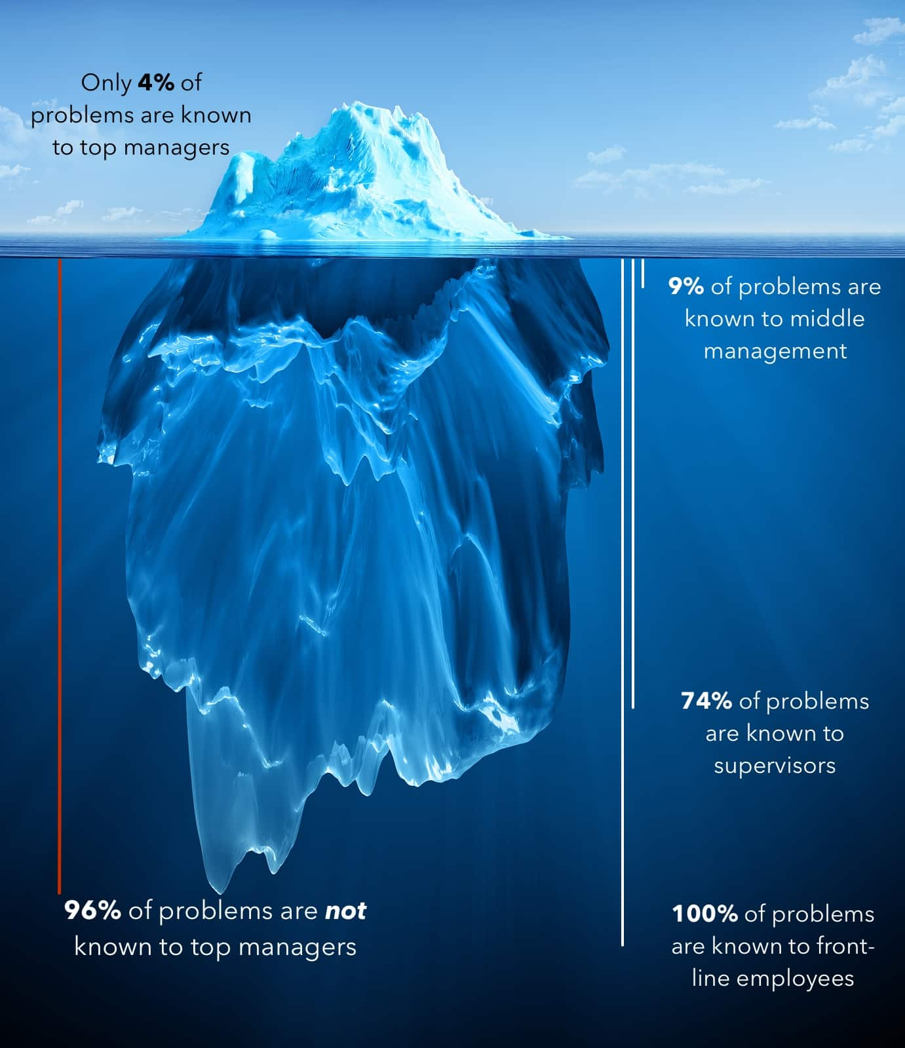
Management & Leadership
Definition of Leadership
Universal characteristics of leaders
Differences between leadership and management
Appreciate the importance of different organisational contexts, academic disciplines and theoretical lenses to practical leadership

Slide 33
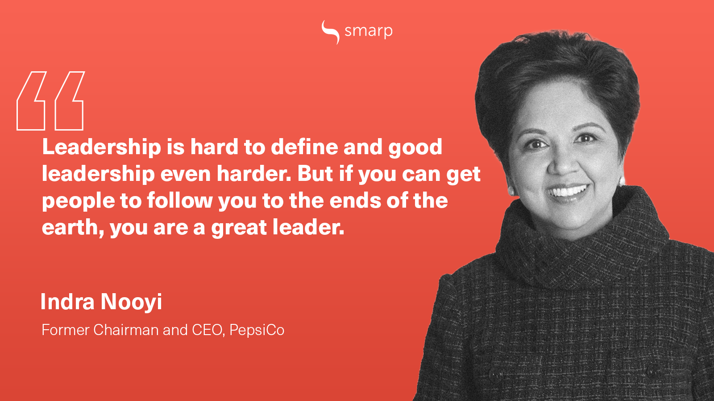

Slide 34

What is Leadership?
‘A slippery concept’ Penrose (1959)
‘Circa 35,000 research articles, magazine articles, and books on the subject’ Dubrin (2001)
Defined in terms of; individual traits, leader behaviour, communication style, role relationships, followership, influence on tasks, and influences on organisational culture
In the context of business; decision making, processes, motivation feedback, interpersonal relationships, direction, value based, results

Slide 35
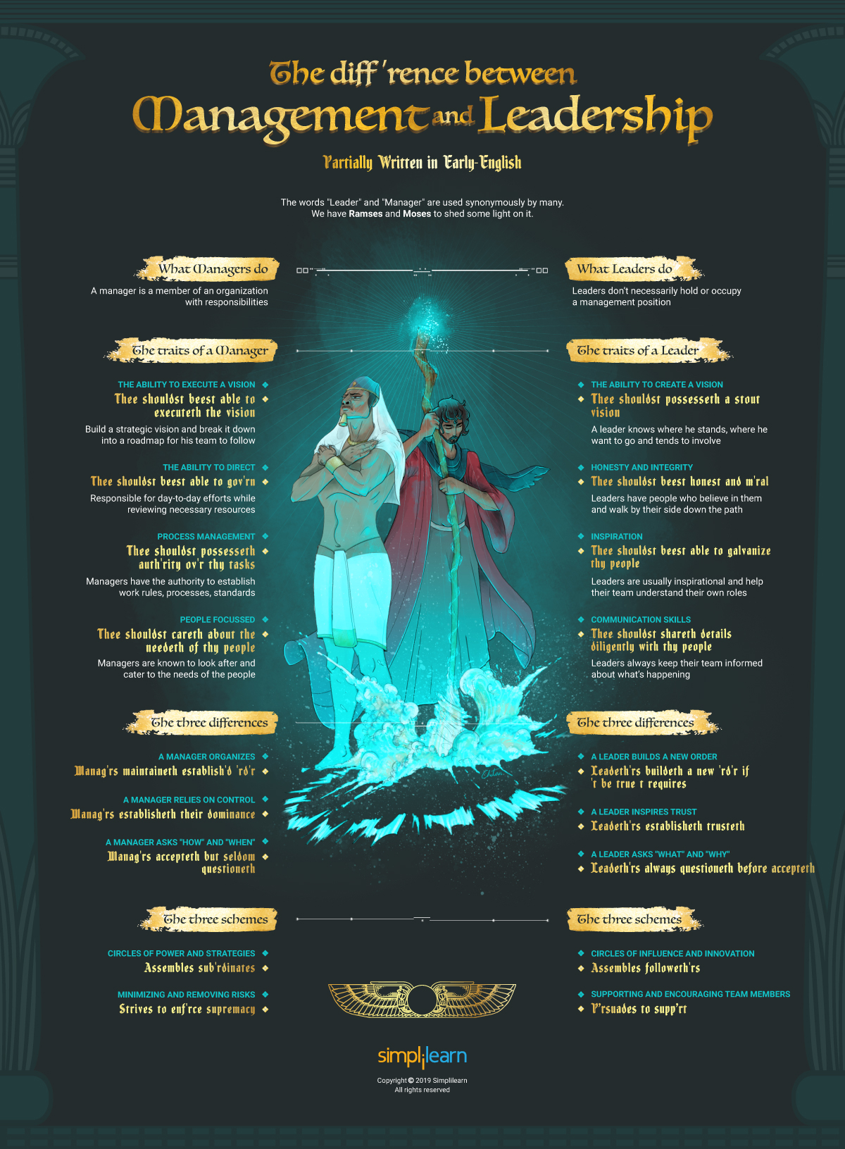
What is Leadership?
A leader is best when people barely know he exists, when his work is done, his aim fulfilled, they will say: we did it ourselves. — Lao Tzu
Where there is no vision, the people perish. — Proverbs 29:18
I must follow the people. Am I not their leader? — Benjamin Disraeli
You manage things; you lead people. — Rear Admiral Grace Murray Hopper

Slide 36

What is Leadership?
Leadership is sometimes more apparent by being ineffective rather than by being effective
People both demand and aspire to leadership and it is seen by many as a mark of success to be considered a leader

Slide 37

What is Leadership?
Kouzes & Posner (2007:132) - bringing the “leadership vision to life” and describe how, in terms of leadership, this “communication of a vision” increases “job satisfaction, motivation, commitment, loyalty, team spirit, productivity and profitability.”
The leadership vision; ‘ideals – hopes, dreams and aspirations’
Admiral Adama “So say we all”

Slide 38
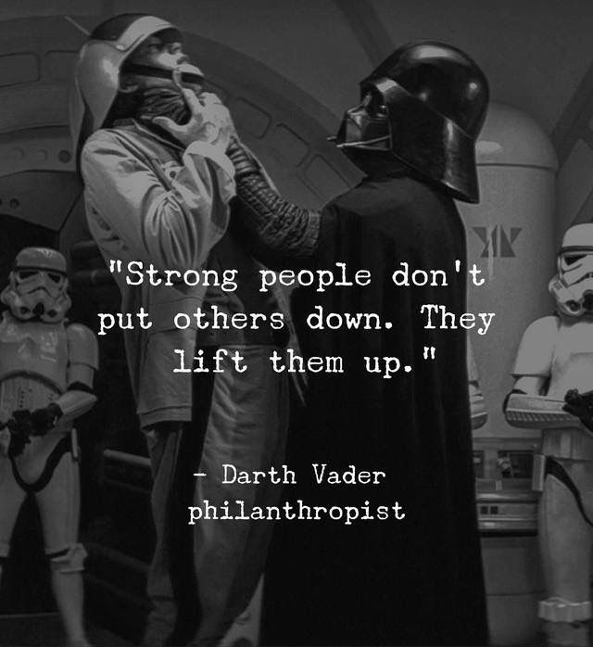
What is Leadership?
The “difference between the great and the lesser leaders, between those who influence their kind abidingly and those who merely mould the clay of present circumstance into the shape of a limited, personal will?” Follett (1928)
Good leaders must have “a tolerance for ambiguity, an ability to hold creative tensions and an ability to care beyond their own personal advantage.” Rohr (2009)

Slide 39
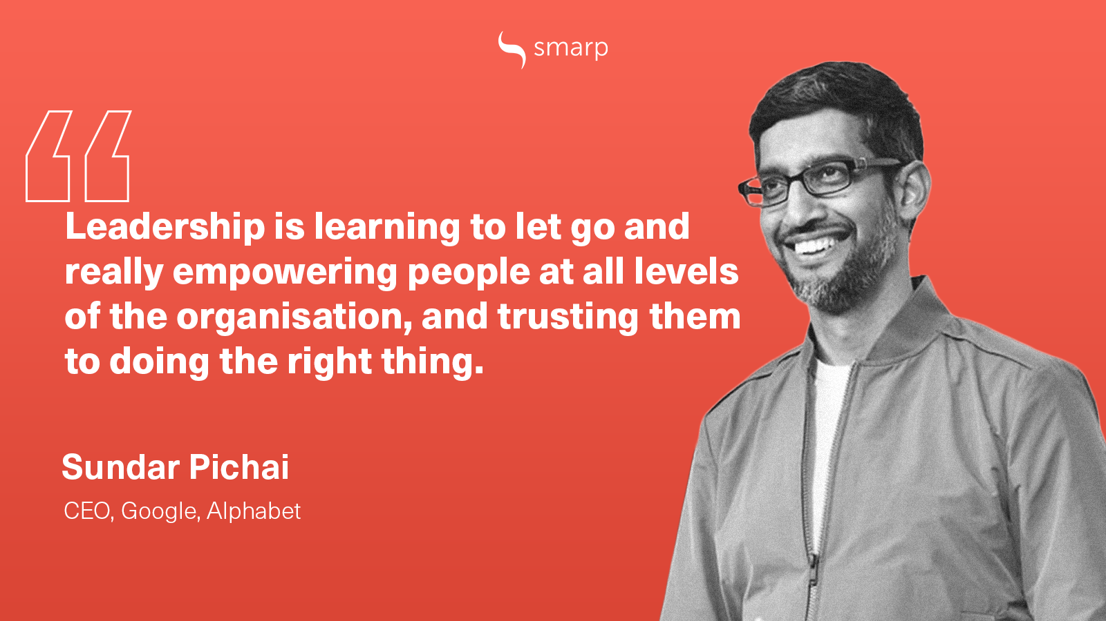

Slide 40
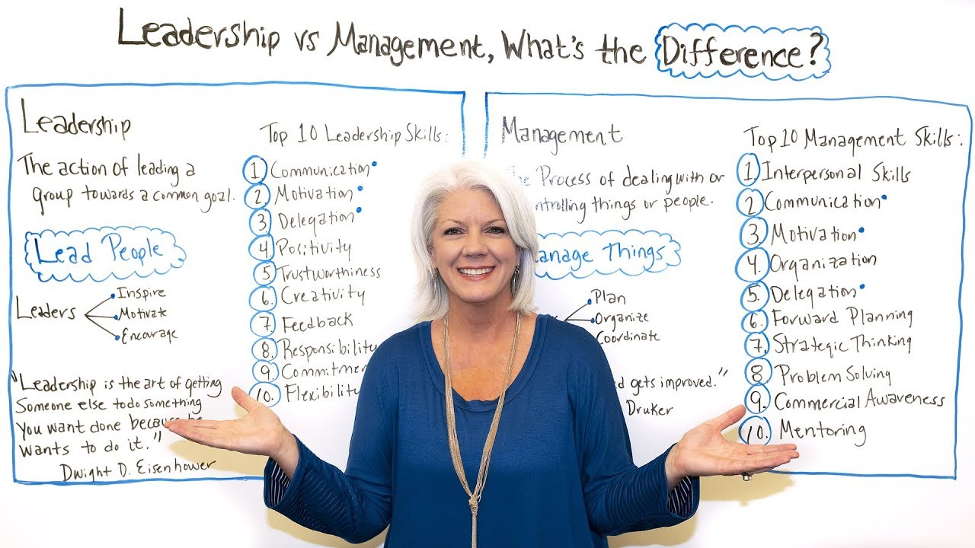

Slide 41

Leaders versus Managers
The manager administers; the leader innovates
The manager is a copy; the leader is an original
The manager maintains; the leader develops
The manager focuses on systems and structure; the leader focuses on people
The manager relies on control; the leader inspires trust

Slide 42
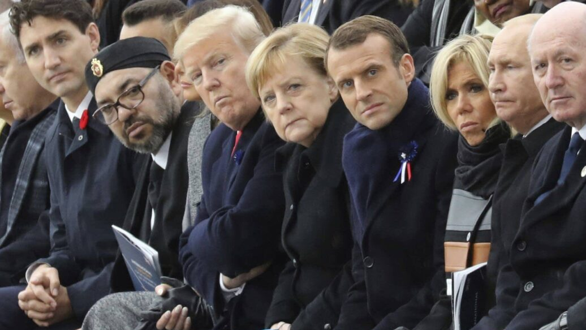
Leaders versus Managers
The manager has a short-range view; the leader has a long-range perspective
The manager asks how and when; the leader asks what and why
The manager has his or her eye always on the bottom line; the leader’s eye is on the horizon
The manager imitates; the leader originates

Slide 43
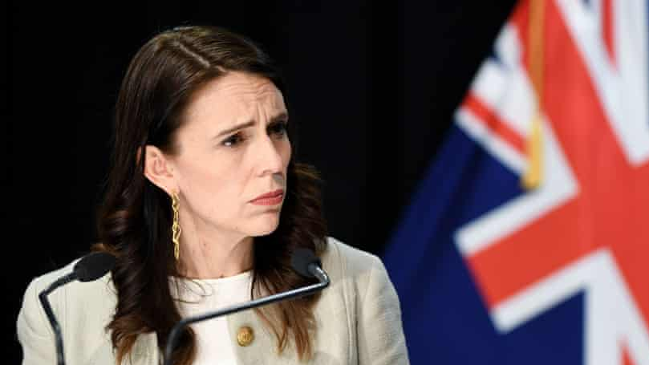
Leaders versus Managers
The manager accepts the status quo; the leader challenges it
The manager is the classic good soldier; the leader is his or her own person
The manager does things right; the leader does the right thing

Slide 44
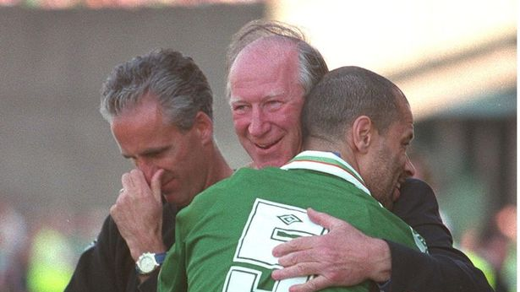
Leaders versus Managers
‘Effective leadership is putting first things first. Effective management is discipline, carrying it out.’ Stephen R. Covey
‘If the manager is not the single most important man at the football club, then why do we sack the manager if it doesn’t go well?’ Arséne Wenger
‘As a player you think about yourself, as a manager you have to think about all twenty-five players.’ Joe Torre, New York Yankees

Slide 45
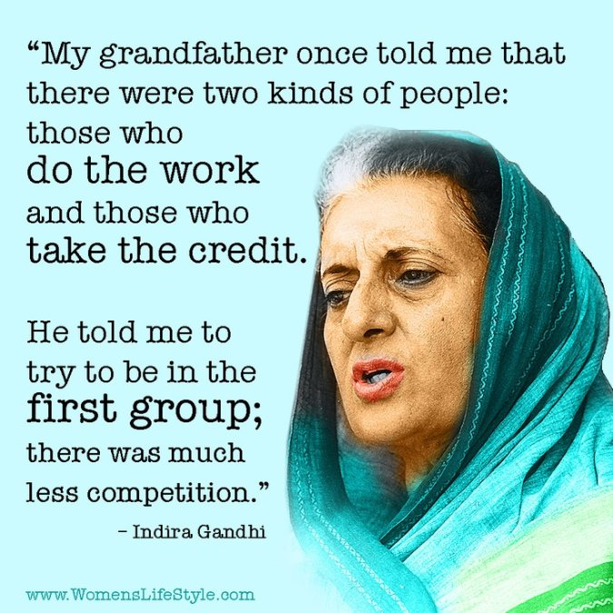
Strategic Leadership Roles
Leadership is the process of influencing an organisation (or group within an organisation) in its efforts towards achieving an aim or goal
Three key roles in leading strategic change:
      Envisioning future strategy
      Aligning the organisation to deliver that strategy
      Embodying change
Note both Senior and Middle managers have a key role in leading change
Beware the “myth of the super-manager” – Cynthia Montgomery

Slide 46
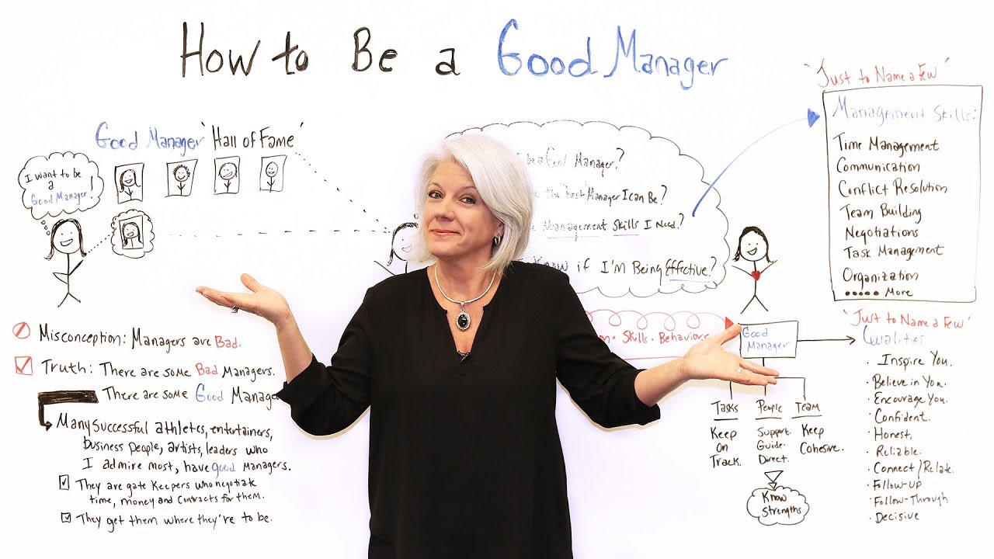

Slide 47

Power
Ability to do something
Capacity for producing an effect
Position and exercise is essential aspect of management
Understanding the nature of power
Skill in the acquisition & use
Recognition of the political nature of an organisation by management
"With great power comes great responsibility" Peter Parker

Slide 48

Social Systems of Organisations
Overt Systems
    Formal authority comes from the aim of the organisation, technology and its attempt to cope with its environment
Cooperative Systems
    Employee career aspirations competing for advancement. Thus effecting decisions taken in the overt system. Can impact individuals in terms of career who will react accordantly
Political Systems
    Relationship individuals and departments compete and cooperate for power
    Inappropriate? leadership, exercise of power, support & influence

Slide 49

Power Influence
Influence defined as the capacity to control and modify the perceptions of others
Power is defined as the capacity to restructure actual situations
Both determine political capability
Politics is when one or more actors attempt to structure a situation so that individual goals are achieved (Macmillan,1978)
A continuum – move from neutral to overt. Can be overt and to dominate may be a better for results

Slide 50

Business as
Political Institutions
Due to the development of a pluralist society all institutions are political institutions defined by their constituencies (Drucker, 1981)
Politics the art of the possible rather than the art of the desirable
Through the exercise of power and influence persuade, induce or coerce
Power base ownership control of recourses, governed by degree of dependence and the extent of alternative available resources
Change of power up and down due to technological, redundancies, environment changes etc.

Slide 51

Power Indicators Johnson & Scholes (1988)
Status of individual or group
Claim on resources
Representation of powerful positions
Symbols of power

Slide 52
Indicators of Power
Within Organisations
Status
Claim on resources
Representation
Symbols
For External Stakeholders
Status
Resource dependence
Negotiation arrangements
Symbols
Johnson, Whittington and Scholes , Exploring Strategy, 9 th Edition, © Pearson Education Limited 2011

Slide 53

Sources of Management Legitimacy (Morgan, 1986)
Formal authority excised by owner or manager
Legislative (Health & Safety)
Established by organisational charts
Delegated authority (Budgets)
Skill or knowledge (Specialists)
Political (Connection)
`Power (Networking)
Charismatic power
Rewards power (Bonuses)
Crisis power (Uncertainty Management)
Countervailing power (HR, Trade Unions)

Slide 54
Sources of Power
Within Organisations
Hierarchy (formal power) e.g. autocratic decision-making
Influence (informal power) e.g. charismatic leadership
Control of strategic resources e.g. strategic products
Possession of knowledge and skills, e.g. computer specialists
Controls of the human environment e.g. negotiation skills
Involvement in strategy implementation, e.g. by exercising discretion
For External Stakeholders
Control of strategic resources e.g. materials, labour, finances
Involvement in strategy implementation e.g. distribution outlets, agents
Possession of knowledge or skills, e.g. subcontractors, partners
Through internal links, e.g. informal influence
Johnson, Whittington and Scholes , Exploring Strategy, 9 th Edition, © Pearson Education Limited 2011

Slide 55

Power Activities (Schein,1978)
Presenting a conservative image
Strike while the iron is hot
Instituting research
Ends justifying the means?

Slide 56

https://www.projectmanager.com/training/10-new-tips-managing

Slide 57
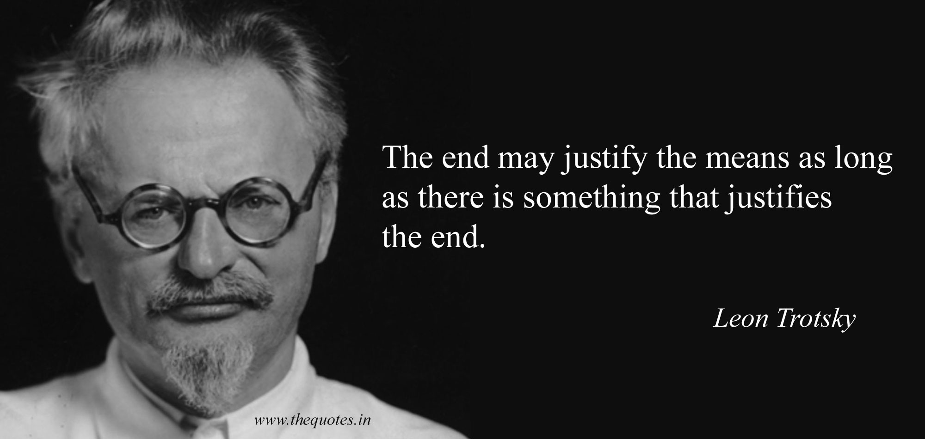

Slide 58
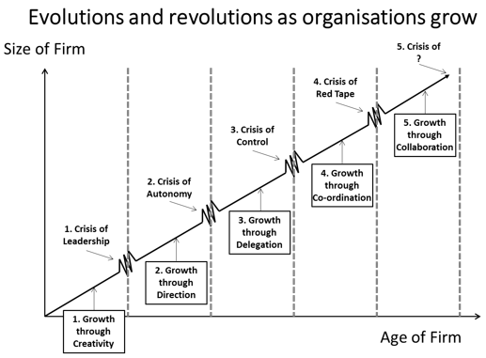
Greiner’s (1972) Growth Model
As a business develops, each phase of growth is followed by a crisis:
    Crisis of leadership follows creativity
    Crisis of autonomy follows direction
    Crisis of control follows delegation
    Crisis of bureaucracy follows coordination
Each phase requires a change in management style or else risks failure
Greiner, Larry E. (1972) “Evolution and revolution as organizations grow”, Harvard Business Review pp. 37-46.
Sources of growth and crises in a growth trajectory of a firm (based on Greiner, 1972)
https://researchleap.com/development-trajectory-innovation-based-environmental-technology-start/

Slide 59
Belbin’s Team Roles
Thinking
Plant – source of ideas & vital spark
Monitor Evaluator – ‘rock’
Specialist – source of technical knowledge
People
Coordinator – natural chairman
Teamworker – counsellor
Resource Investigator – ‘fixer’
Action
Shaper – self-elected leader
Implementer – ‘workhorse’
Completer Finisher – ‘worry-guts’
To be effective all nine roles must be present within a team

Slide 60
Large Organisation Stakeholders
Firm
Owners Shareholder
Financial Community
Activist Groups
Customers
Managers
Unions
Employees
Trade Associations
Competitors
Suppliers
Government
Political Groups
Adapted from R. E. Freeman, Strategic Management: A Stakeholder Approach , Pitman, 1984. Copyright 1984 by R. Edward Freeman. Johnson, Whittington and Scholes , Exploring Strategy, 9th Edition, © Pearson Education Limited 2011

Slide 61
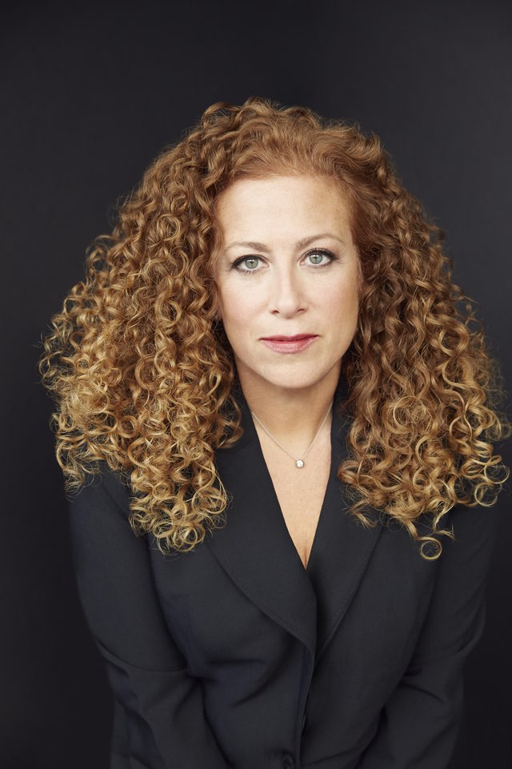
Stakeholders
Conflicts of Expectations
In order to grow short-term profitability, cash flow and pay levels may need to be sacrificed
Short-termism may suit managerial career aspirations but preclude investment in long-term projects
When family businesses grow, the owners may lose control if they need to appoint professional managers
New developments may require additional funding through share issue or loans, in either case, financial independence may be sacrificed
Public ownerships of shares will require more openness and accountability from the management
Cost efficiently through capital investment can mean job losses
Extending into mass markets may require a reduction in quality standards
In public services, a common conflict is between mass provision and specialist services (e.g. preventative dentistry or heart transplants)
In large multinationals organisations, conflict can result because of a division’s responsibilities to the company and also to its host country
“A mathematical formula for happiness: Reality divided by Expectations. There were two ways to be happy: improve your reality or lower your expectations.” Jodi Picoult, Nineteen Minutes
“There are two ways to be happy: improve your reality, or lower your expectations.”
Jodi Picoult, Nineteen Minutes

Slide 62
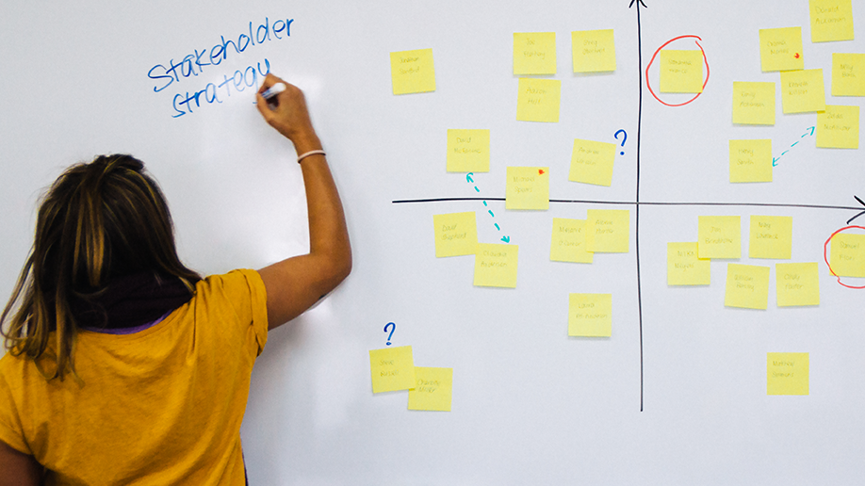
Stakeholder Mapping
Stakeholder mapping identifies stakeholder expectations and power and helps in understanding political priorities

Slide 63
Stakeholder Mapping
Power/Interest Matrix
Level of Interest
Level of Interest
Low
High
Low
A Minimal Effort | B Keep Informal
C Keep Satisfied | D Key Players
Power
High
Adapted from A. Mendelow, Proceedings of the Second International Conference on Information Systems , Cambridge, MA, 1986 Johnson, Whittington and Scholes , Exploring Strategy, 9th Edition, © Pearson Education Limited 2011

Slide 64
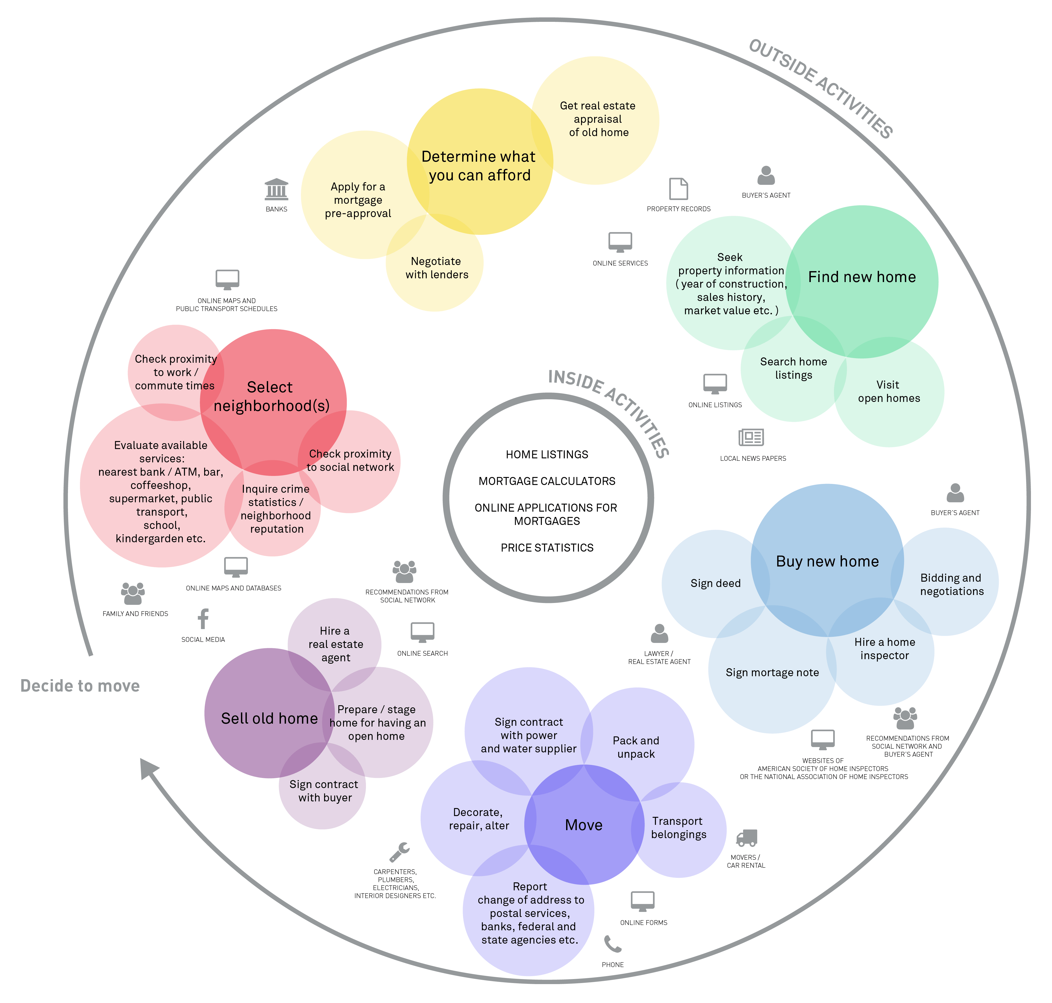
Stakeholder Mapping Issues
Whose expectations need to be prioritised?
Do the actual levels of interest and power reflect the corporate governance framework?
Who are the key blockers and facilitators of strategy?
Is it desirable to try to reposition certain stakeholders?
Can the level of interest or power of key stakeholders be maintained?
Will stakeholder positions shift according to the issue/strategy being considered?

Slide 65

Conflict

Slide 66

Conflict
Conflict inevitable as needs & objectives between stakeholders vary
  Line, Central & Operations
  Organisation & Suppliers
  Trade Union & Employers
  Competitive Environments
  Need to Change
  Internal & External
  Print –v- Virtual
“If I have to choose between agreement and conflict. I’ll take conflict. It always yields a better result” (Jeff Bezos, 2021, Amazon Abound)

Slide 67
Conflict Handling Styles (Blake & Mouton, 1964)
Two Key Axis
Five Styles
Various models based on Managerial Grid Models
Concern for People
Concern for Tasks
Desirable
Compromising (worst of both worlds?)
Collaborative
Undesirable
Aggressive
Avoidance
Accommodation (can reinforce, prolong conflict)

Slide 68
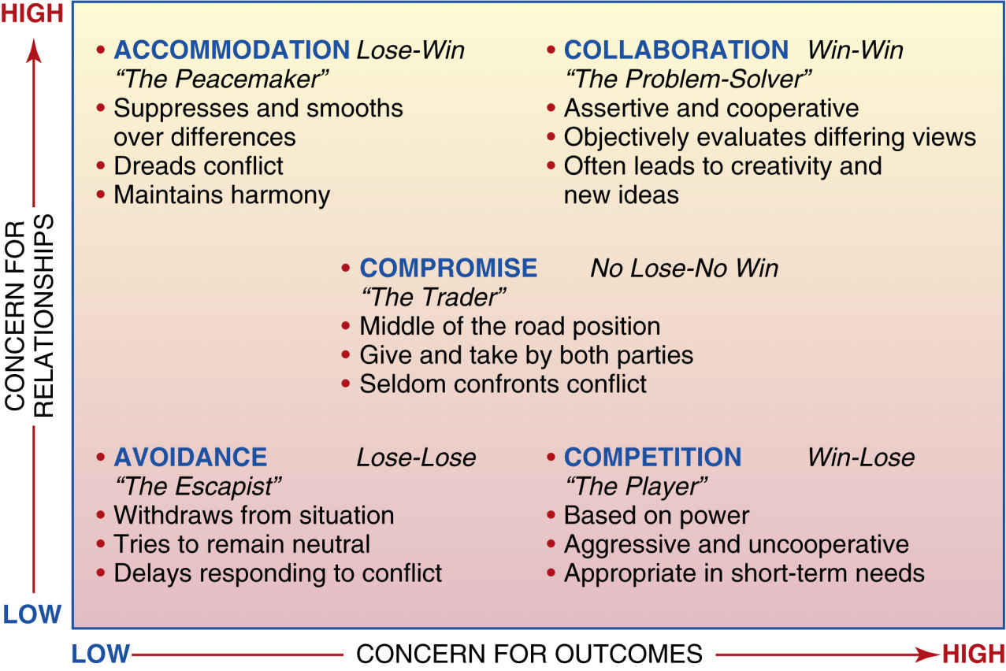
Conflict Handling Styles

Slide 69
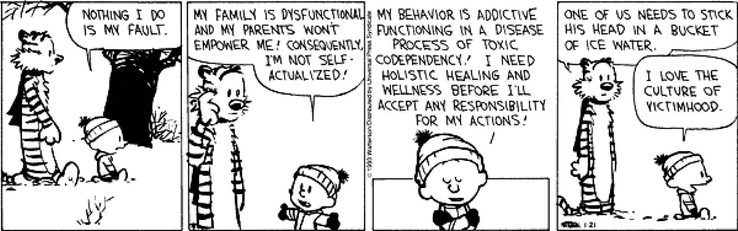
Repair Techniques (Edgar Schein, 1980)
Coming to terms with your own psychological blockages
Being afraid to address the issue will cause the issue to be repeated and therefore prevents peoples from building bridges
Blame Game
Them & Us

Slide 70

Know Yourself Techniques
Seek new elements
    No assumptions
Look for superordinate goals that a new set of relationships can be built
See their point of view
    Walk-in-my-shoes
Talk to a colleague who is a good listener - good if the blockage is hurt or anger
Time is a healer

Slide 71
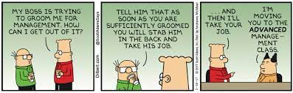
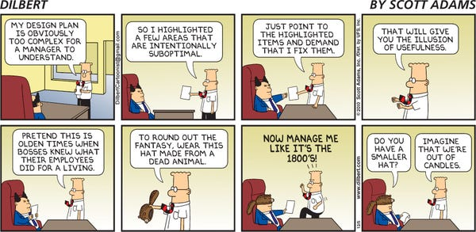
Conclusion
Management is no longer seen as the controlling factor in work organisations
Management is seen as a function of organisations
The task of management is to enable the organisations purposes to be defined by adapting to change and maintaining a workable balance between the various, and frequently conflicting, pressures at work in the organisation

